Slide 1

Chattisgarh swami vivekanand technical university
Name: Likhitha
Sec: Data science
Ethics assignment-2
Guided by: Viveksir

Slide 2

SECURITY
(Reference to society)

Slide 3
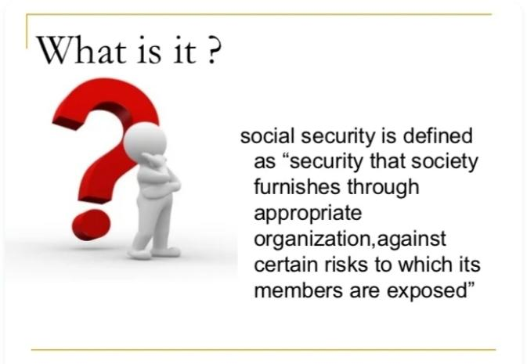

Slide 4
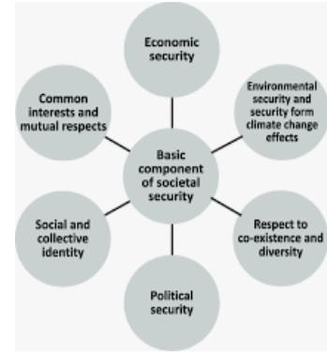

Slide 5
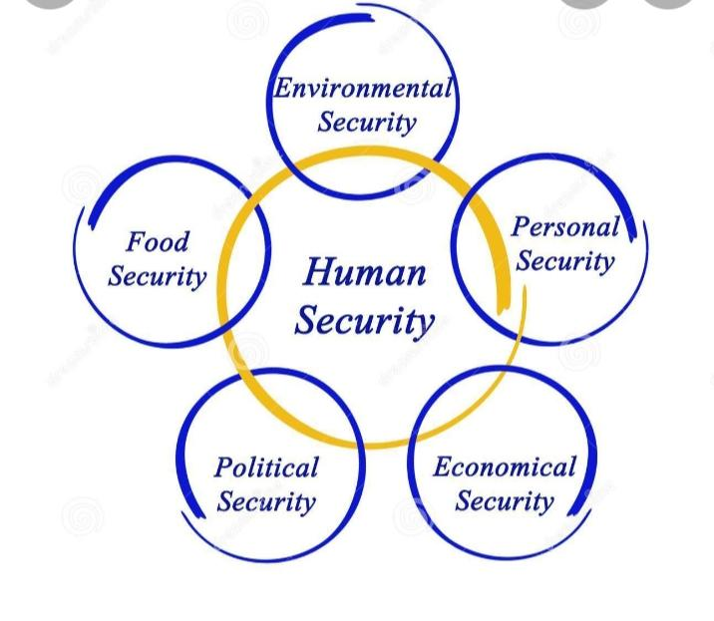

Slide 6
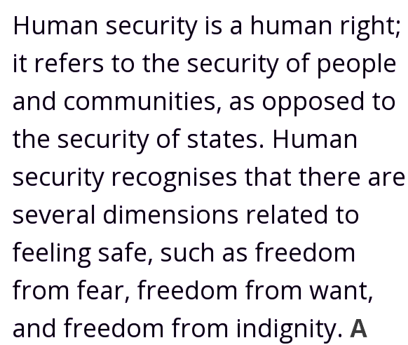
Human security

Slide 7
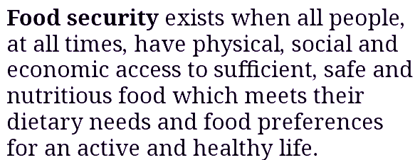
Food security

Slide 8
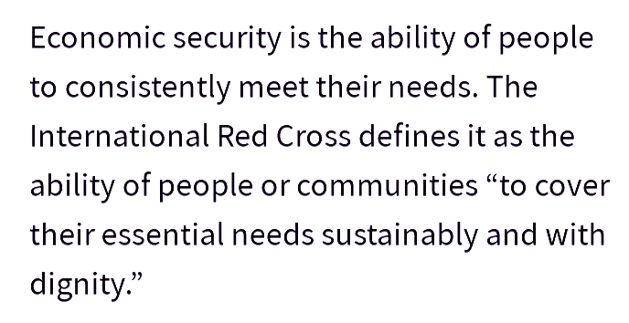
Economic security

Slide 9
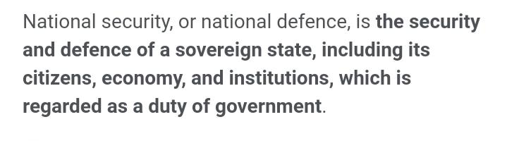
National security

Slide 10
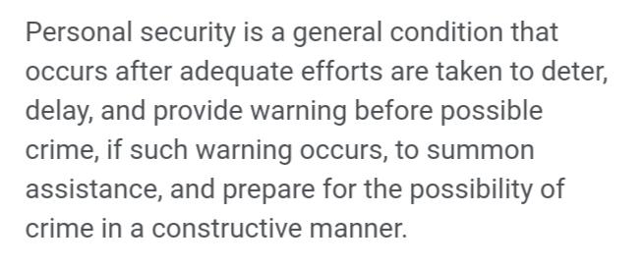
Personal security

Slide 11
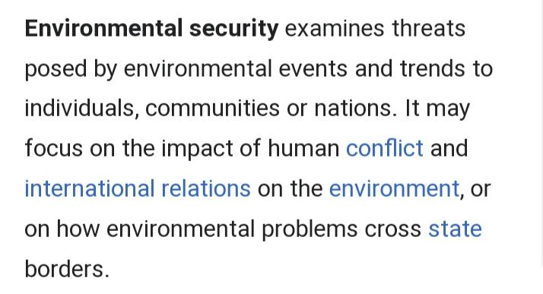
Environmental security

Slide 12
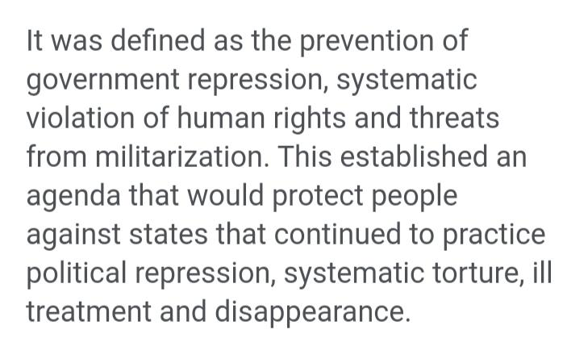
Political security

Slide 13


Slide 14


